Slide 1
Introduction to Deep Learning
Yu Cheng IBM T.J. Watson Research Center chengyu@us.ibm.com March 31th, 2016

Slide 2
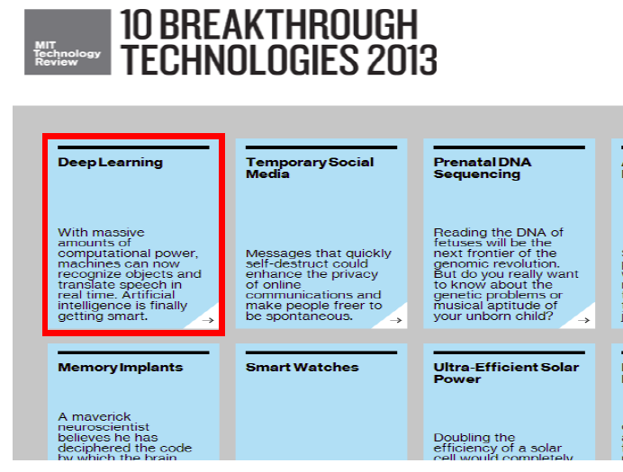
Success of Deep Learning

Slide 3
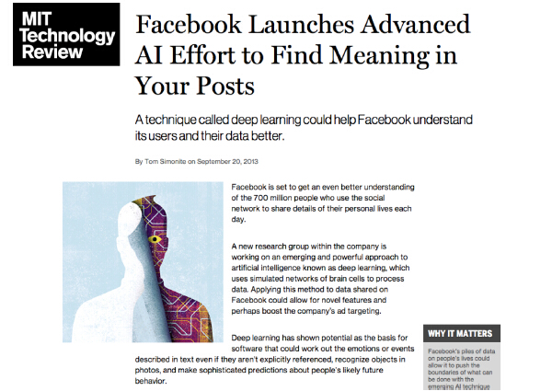
Success of Deep Learning

Slide 4
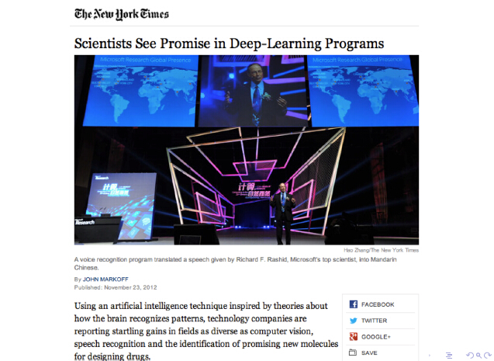
Success of Deep Learning

Slide 5
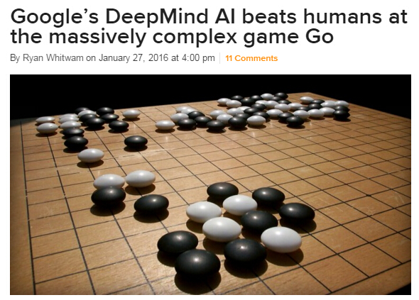
Success of Deep Learning

Slide 6
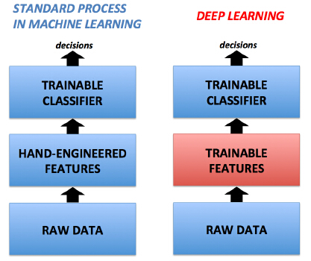
What is Deep Learning?
Definition
A family of methods that uses deep architectures to learn high-level feature representations.

Slide 7
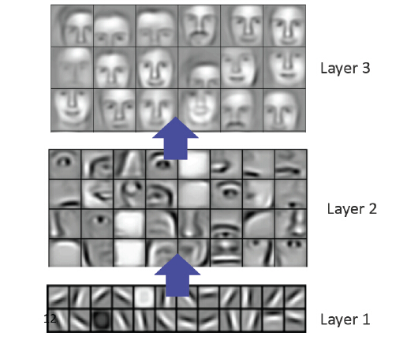
Example of trainable features

Slide 8
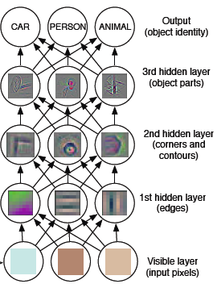
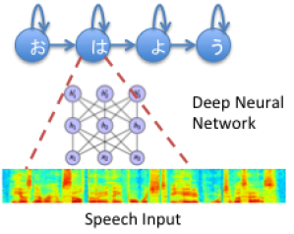
Why do we need deep model?
Why Deep Model?
Fill in the gap between low-level feature and semantic meaning Learn useful high-level abstraction with less variant/noise
object
sentence
pixels
signals

Slide 9
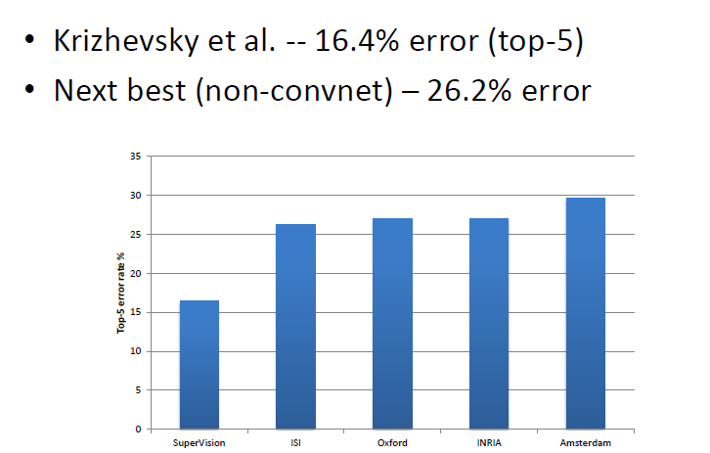
Success in Computer Vision

Slide 10
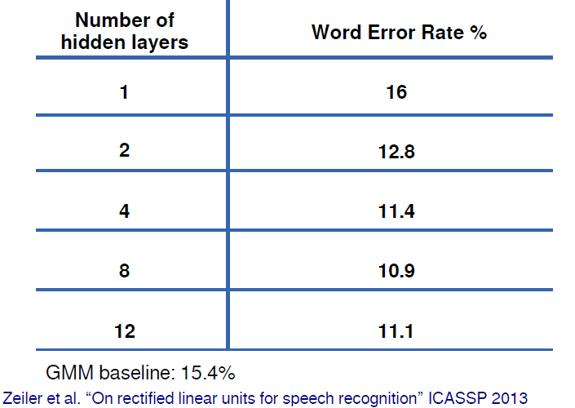
Success in Speech Recognition

Slide 11
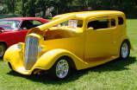
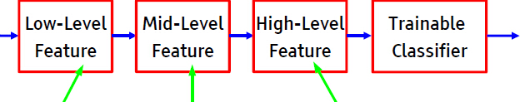
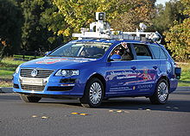
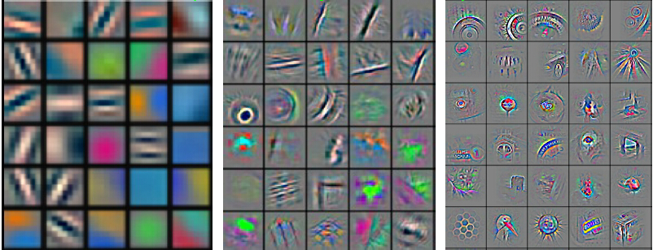
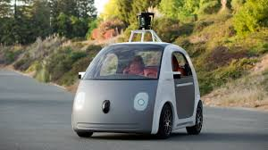
Why do we need deep model?
Why Deep Model?
Fill in the gap between low-level feature and semantic meaning Learn useful high-level abstractions with less variant/noise

Slide 12
Course Outline
Goal:
To understand the foundations of neural networks and deep learning, at a level sufficient for reading recent research papers
Schedule:
- Basic of DNN
- Different types of DNN
- Advanced topics in DNN

Slide 13
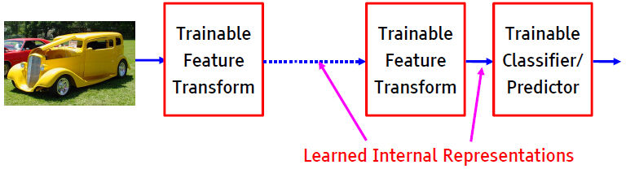
Which structure is deep?
Structures with more than one (>=2) stage of nonlinear, trainable feature transform

Slide 14
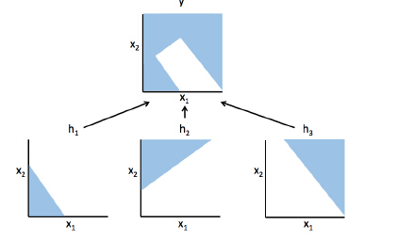
Why is deep structure powerful?
1-layer only model liner hyperplanes
2-layer with infinite hidden nodes can express any continuous functions
>2-layer can do this with less nodes

Slide 15
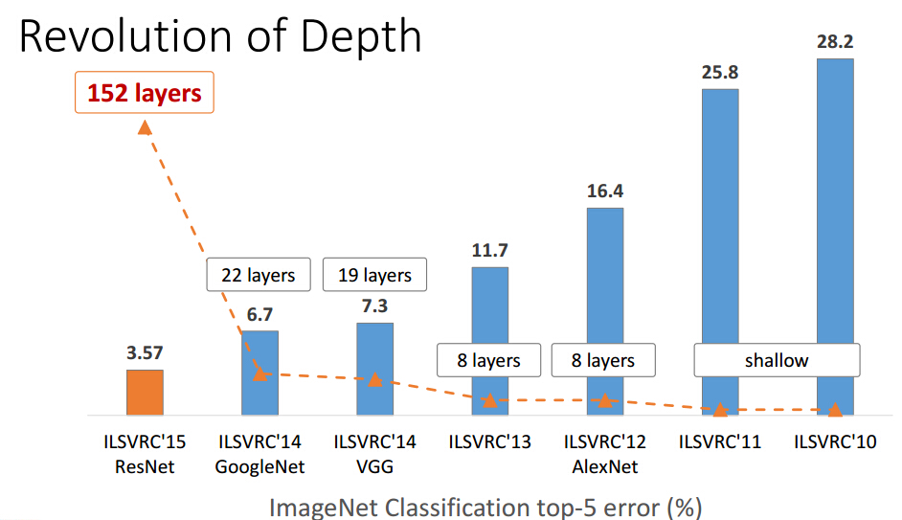
Deeper = Better?
Yes (for performance)

Slide 16
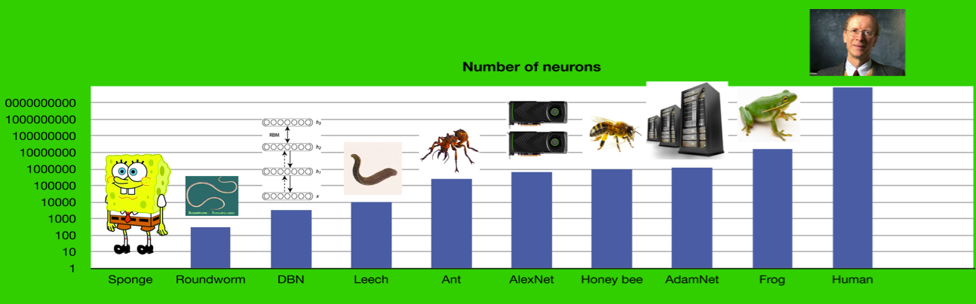
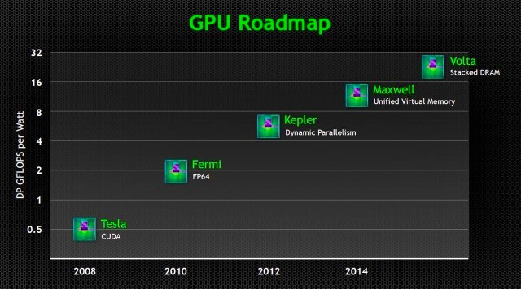
Deeper = Better?
No ☺
You need to consider the deep net structure, the sufficiency of training set, and balance of effective vs. efficiency etc.
Generalization and Optimization

Slide 17
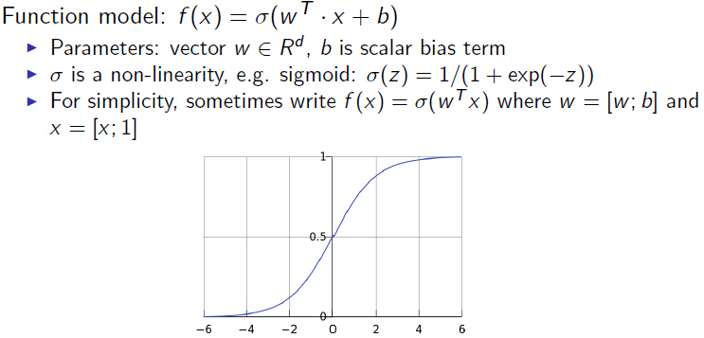
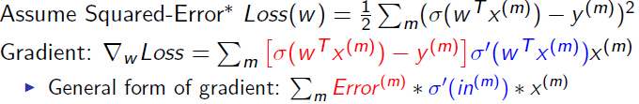
Basic of DL I

Slide 18
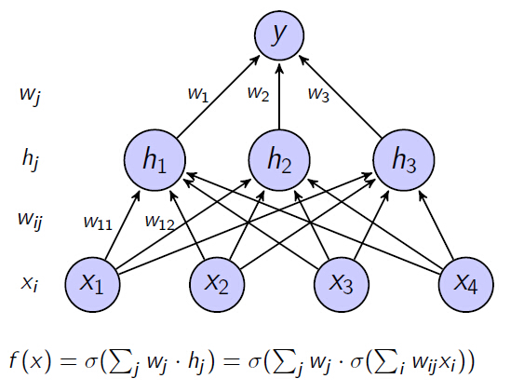
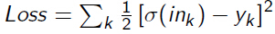
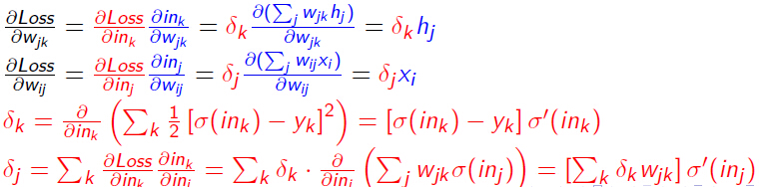
Basic of DL II

Slide 19
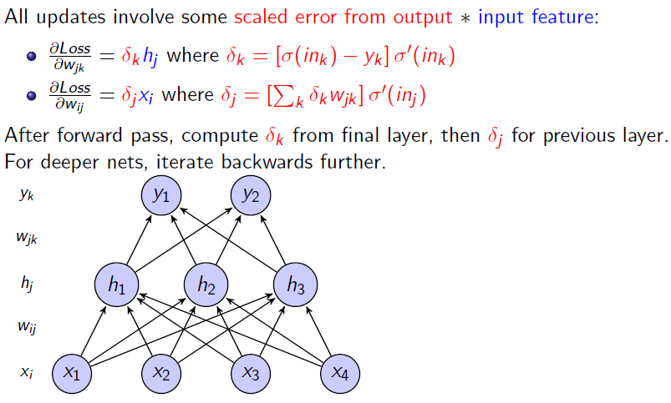
Basic of DL III

Slide 20
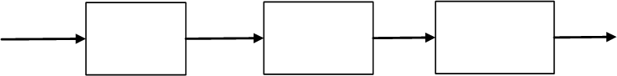
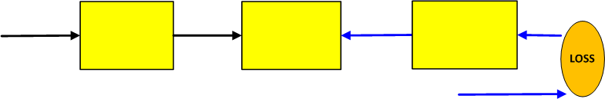
Forward-backward propagation
Forward propagation:
Backward propagation:
(Chain Rule)

Slide 21
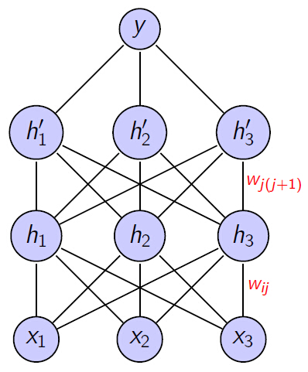
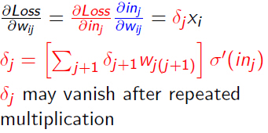
Why are deep architectures hard to train?
Vanishing gradient problem in backward propagation
Insufficient training data

Slide 22
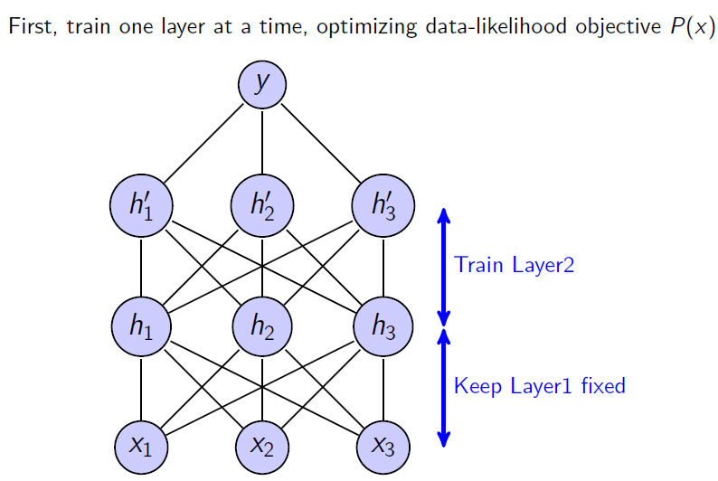
Layer-wise pre-training [Hinton et al. 2006]

Slide 23
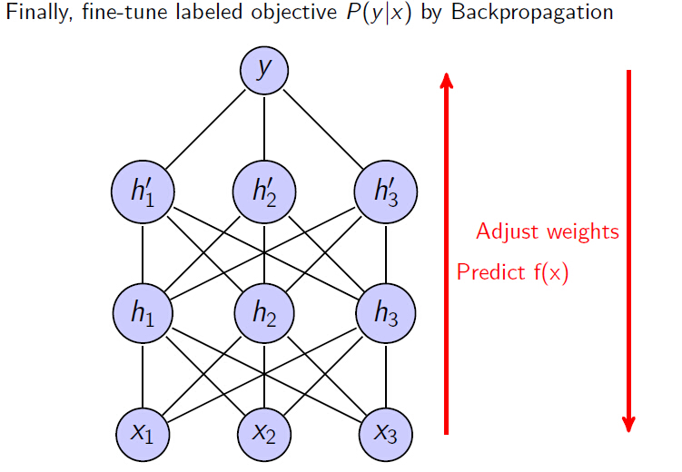
Layer-wise pre-training [Hinton et al. 2006]

Slide 24
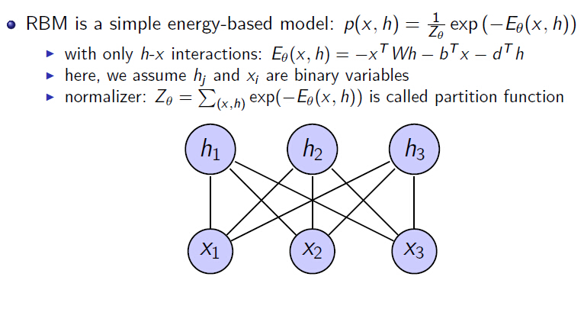
Restricted Boltzmann Machine (RBM)

Slide 25
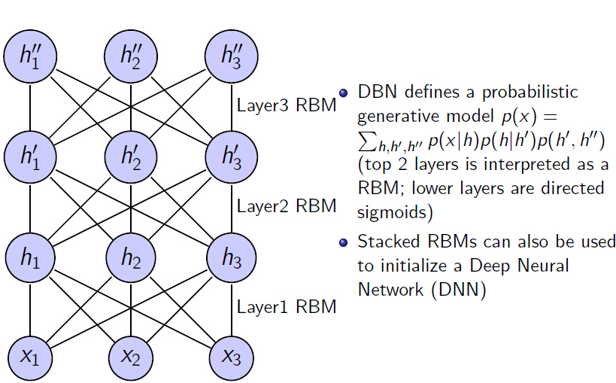
Deep Belief Nets (DBN) = Stacked RBM

Slide 26
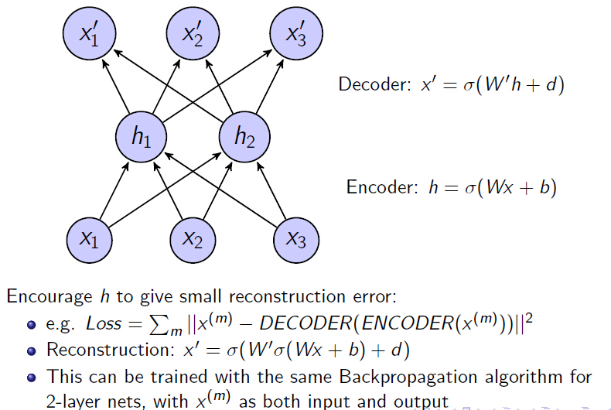
Auto-Encoders: simpler alternatives to RBMs

Slide 27
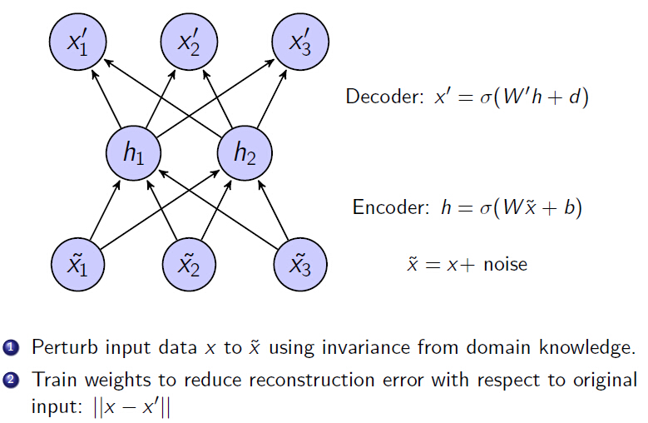
Denoising Auto-Encoders

Slide 28
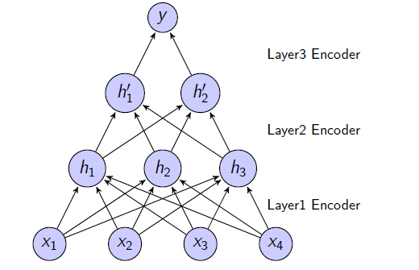
Stacked Auto-Encoders (SAE)

Slide 29
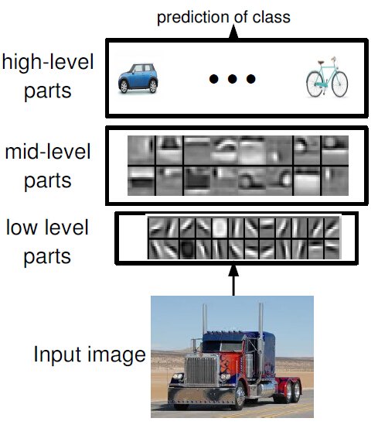
Convolutional Neural Networks

Slide 30
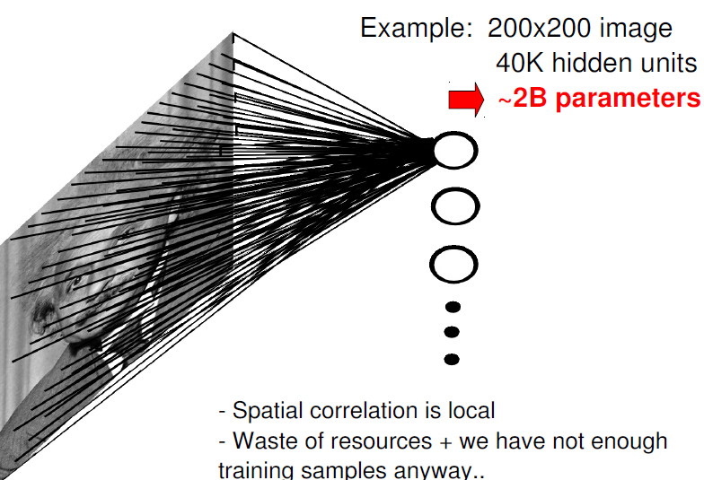
Fully Connected Layer

Slide 31
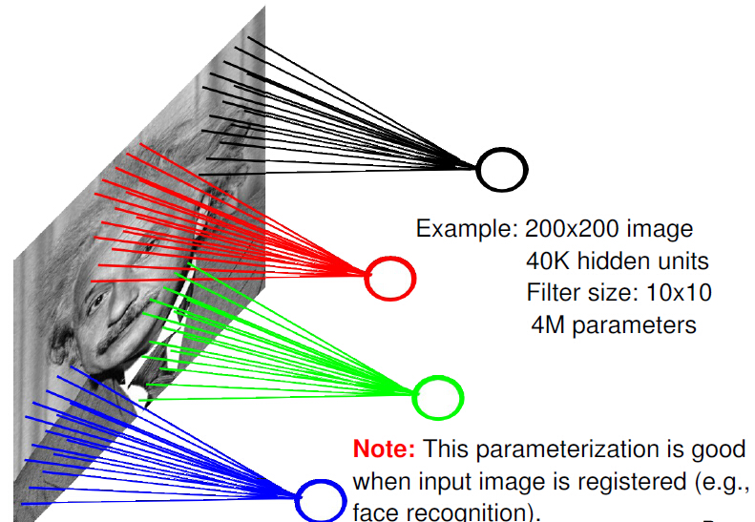
Locally Connected Layer

Slide 32
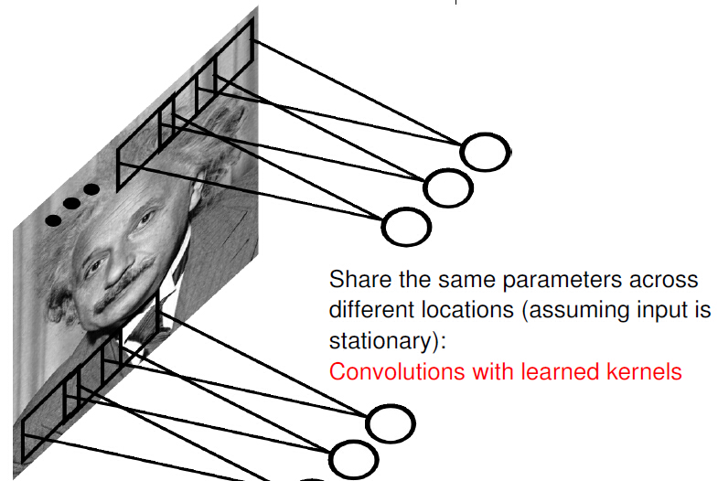
Convolutional Layer

Slide 33
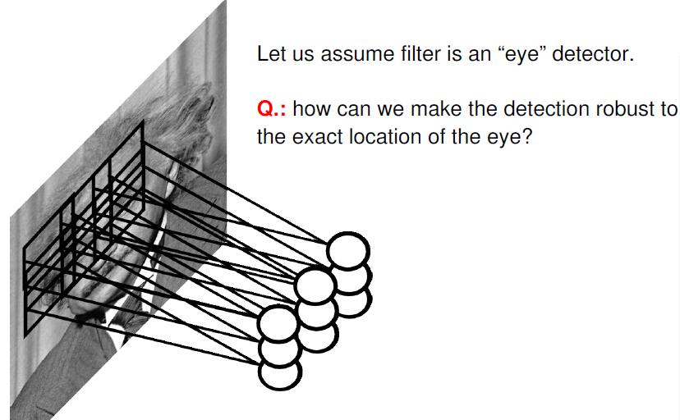
Pooling Layer

Slide 34
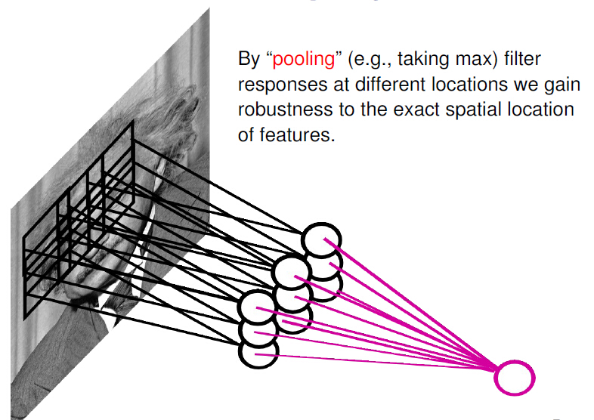
Pooling Layer

Slide 35
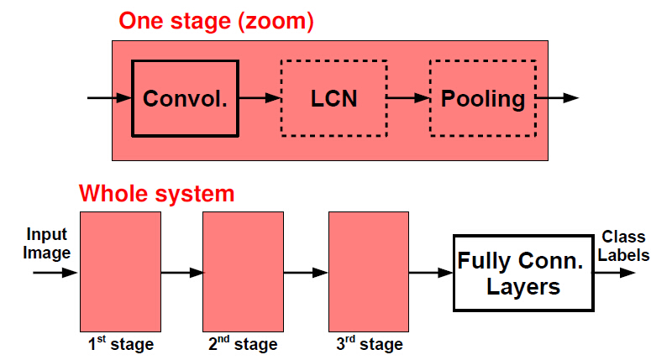
ConvNets: Typical Architecture

Slide 36
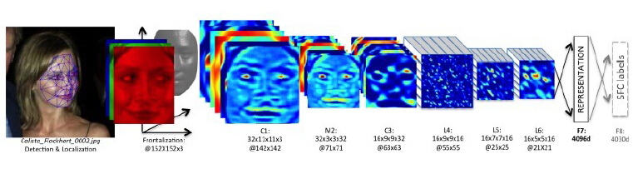
Examples – DeepFace

Slide 37
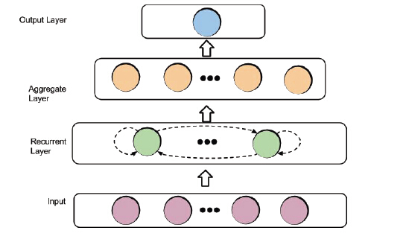
Recurrent Neural Networks
Input: sequential data/time series

Slide 38
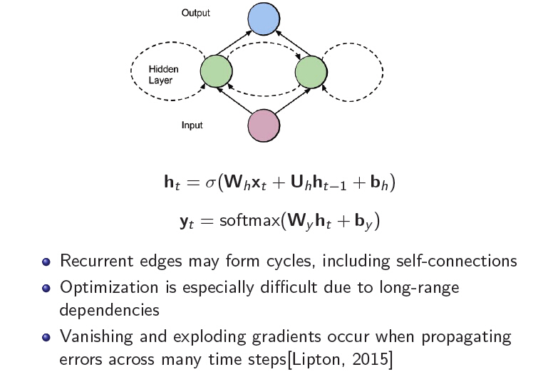
Simple Recurrent Neural Net

Slide 39
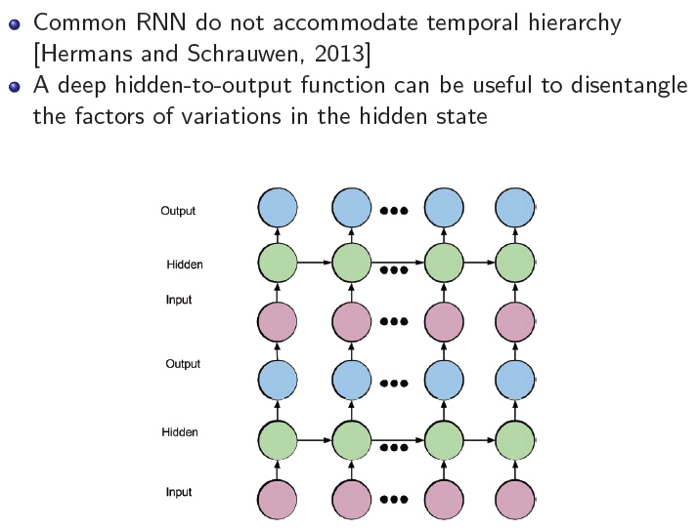
Stacking Recurrent Layer: deep RNN models

Slide 40
DNN Tools
Caffe: http://caffe.berkeleyvision.org/
Torch: http:// www.torch.ch
Theano: http://deeplearning.net/software/theano/
TensorFlow: https://www.tensorflow.org/
DeepLearnToolbox: https://github.com/rasmusbergpalm/DeepLearnToolbox
Pylearn2: https://github.com/lisa-lab/pylearn2

Slide 41
Advanced Topics in DL
There are many exciting new works out of ICML/NIPS. I just pick 3 that I think is most interesting.
Scaling to large data
Parameters reduction
Deep generative model

Slide 42
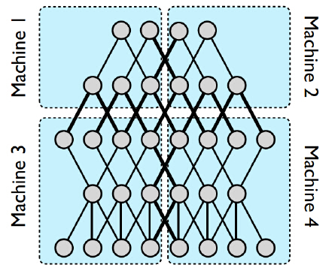
Model Parallelism
Deep net is stored and processed on multiple cores (multi-thread) or machines (message passing)
Performance benefit depends on connectivity structure vs. computational demand

Slide 43
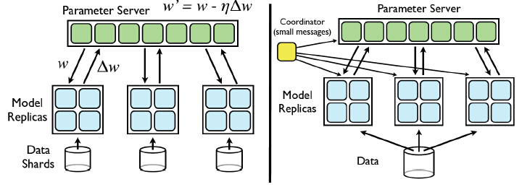
Data Parallelism
Left: Asynchronous SGD
Right: Distributed L-BFGS

Slide 44

Parameters Reduction
Time complexity O(nlogd), space complexity O(n)

Slide 45


Parameters Reduction
Time complexity O(dlogd), space complexity O(d)

Slide 46
Deep Generative Model
Goal: use similar structure as general DNN, but make strong assumptions concerning the distribution of latent variables
Training: stochastic gradient variational Bayes
Works:
- Auto-Encoding Variational Bayes
- Semi-supervised learning with deep generative models
- Deep Kalman Filter

Slide 47
Question?

